Slide 1
Integrate Log Analytics with Power BI
Visualizing and analyzing log data effectively
Notes:
Generated by Copilot Integrating Log Analytics with Power BI is crucial for visualizing and analyzing log data effectively. This integration allows organizations to transform raw log data into meaningful insights, enabling better decision-making. By leveraging Power BI's capabilities, users can create dynamic reports and dashboards that highlight trends and anomalies in their log data, ultimately enhancing operational efficiency and responsiveness. ______
AI-generated content may be incorrect. --- This presentation will guide you through the integration of Log Analytics with Power BI, showcasing how to effectively visualize and analyze your log data. We will cover the necessary prerequisites, permissions, and steps for creating reports and dashboards using Power BI.

Slide 2
Introduction to Log Analytics and Power BI Integration
Notes:
Generated by Copilot Understanding the integration of Log Analytics and Power BI is essential for maximizing data insights. This integration not only streamlines data visualization but also enhances reporting capabilities, allowing users to derive actionable insights from their log data. It's important to recognize how these tools complement each other in providing a comprehensive view of data analytics. ______
--- This slide references information from the following file: https://microsoft-my.sharepoint.com/personal/chadtoney_microsoft_com/Documents/Documents/Teaching%20and%20Training/Feb%205%202025%20Log%20Analytics%20PBI/Log%20Analytics%20integration%20with%20Power%20BI%20and%20Excel%20-%20Azure%20Monitor%20_%20Microsoft%20Learn.pdf Overview of Log Analytics and Power BI

Slide 3

Overview of Log Analytics and Power BI
Integration Overview
Integrating Log Analytics with Power BI allows for seamless data visualization and reporting based on log data.
Azure Monitor Logs
Azure Monitor Logs provides an effective end-to-end solution for ingesting and querying log data.
Data Visualization
Power BI transforms log data into insightful reports and dashboards, enabling better decision-making.
Notes:
Generated by Copilot The integration of Log Analytics with Power BI facilitates seamless data visualization and reporting. Azure Monitor Logs serves as a robust solution for ingesting and querying log data, while Power BI excels in transforming this data into insightful reports and dashboards. This combination empowers organizations to make informed decisions based on real-time data analysis. ______
--- This slide references information from the following file: https://microsoft-my.sharepoint.com/personal/chadtoney_microsoft_com/Documents/Documents/Teaching%20and%20Training/Feb%205%202025%20Log%20Analytics%20PBI/Log%20Analytics%20integration%20with%20Power%20BI%20and%20Excel%20-%20Azure%20Monitor%20_%20Microsoft%20Learn.pdf Integrate Log Analytics with Power BI Article • 09/11/2024 Azure Monitor Logs provides an end-to-end solution for ingesting logs. From Log Analytics, Azure Monitor's user interface for querying logs, you can connect log data to Microsoft's Power BI data visualization platform. This article explains how to feed data from Log Analytics into Power BI to produce reports and dashboards based on log data.

Slide 4
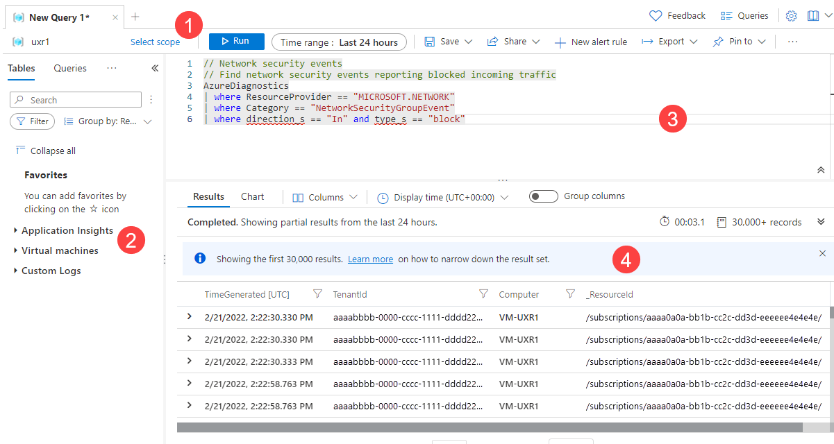
Log Analytics interface
The following image identifies four Log Analytics components. These four Log Analytics components are:
Top action bar
Left sidebar
Query window
Results window
Notes:
Generated by Copilot Log Analytics is a powerful tool within the Azure portal that enables users to run and refine log queries against the Azure Monitor Logs store. It leverages Kusto Query Language (KQL), which is designed for querying large datasets efficiently. The tool offers a user-friendly point-and-click interface in its simple mode, making it accessible for users who may not be familiar with KQL. This flexibility allows for both interactive analysis and integration with other Azure Monitor features, such as log search alerts and workbooks. By utilizing Log Analytics, teams can gain deeper insights into their log data, enhancing their ability to monitor and respond to system performance and security issues effectively. ______

Slide 5

Required Tools and Accounts
Power BI Features
Power BI offers features for integration, report creation, and dashboard building, suitable for basic usage.
Advanced Features
For features like sharing, scheduled refreshes, and dataflows, a Power BI Pro or Premium account is required.
Power BI Desktop Requirement
Exporting queries to .txt files for Power BI requires the use of Power BI Desktop.
Azure Permissions
A Power BI account and Azure permissions are necessary for creating datasets and logging.
Notes:
Generated by Copilot To effectively utilize Power BI with Log Analytics, certain tools and accounts are necessary. Power BI offers various features for integration and report creation, but advanced functionalities require a Pro or Premium account. Additionally, using Power BI Desktop is essential for exporting queries, and appropriate Azure permissions are needed to create datasets and manage logs. ______
--- This slide references information from the following file: https://microsoft-my.sharepoint.com/personal/chadtoney_microsoft_com/Documents/Documents/Teaching%20and%20Training/Feb%205%202025%20Log%20Analytics%20PBI/Log%20Analytics%20integration%20with%20Power%20BI%20and%20Excel%20-%20Azure%20Monitor%20_%20Microsoft%20Learn.pdf You can use free Power BI features to integrate and create reports and dashboards. More advanced features, such as sharing your work, scheduled refreshes, dataflows, and incremental refresh might require purchasing a Power BI Pro or Premium account. For more information, see Learn more about Power BI pricing and features . Prerequisites To export the query to a .txt file that you can use in Power BI Desktop, you need Power BI Desktop . To create a new dataset based on your query directly in the Power BI service: You need a Power BI account. You must give permission in Azure for the Power BI service to write logs. For more information, see Prerequisites to configure Azure Log Analytics for Power BI.

Slide 6
Permissions Required
Notes:
Generated by Copilot Permissions play a critical role in the integration process. Ensuring that users have the correct access rights is vital for a smooth workflow when working with Log Analytics and Power BI. ______
--- This slide references information from the following file: https://microsoft-my.sharepoint.com/personal/chadtoney_microsoft_com/Documents/Documents/Teaching%20and%20Training/Feb%205%202025%20Log%20Analytics%20PBI/Log%20Analytics%20integration%20with%20Power%20BI%20and%20Excel%20-%20Azure%20Monitor%20_%20Microsoft%20Learn.pdf Necessary Permissions for Exporting Queries

Slide 7

Necessary Permissions for Exporting Queries
Read Permissions
To export queries to a .txt file, you need read permissions for Log Analytics workspaces, offered by the Log Analytics Reader role.
Write Permissions
To create a new dataset in Power BI, you require write permissions for the Log Analytics workspaces, provided by the Log Analytics Contributor role.
Notes:
Generated by Copilot Exporting queries from Log Analytics requires specific permissions. Read permissions are necessary to access the data, while write permissions are essential for creating datasets in Power BI. Understanding these roles is crucial for effective data management and reporting. ______
--- This slide references information from the following file: https://microsoft-my.sharepoint.com/personal/chadtoney_microsoft_com/Documents/Documents/Teaching%20and%20Training/Feb%205%202025%20Log%20Analytics%20PBI/Log%20Analytics%20integration%20with%20Power%20BI%20and%20Excel%20-%20Azure%20Monitor%20_%20Microsoft%20Learn.pdf Permissions required To export the query to a .txt file that you can use in Power BI Desktop, you need Microsoft.OperationalInsights/workspaces/query/*/read permissions to the Log Analytics workspaces you query, as provided by the Log Analytics Reader built-in role, for example. To create a new dataset based on your query directly in the Power BI service, you need Microsoft.OperationalInsights/workspaces/write permissions to the Log Analytics workspaces you query, as provided by the Log Analytics Contributor built-in role, for example.

Slide 8
Creating Power BI Datasets and Reports
Notes:
Generated by Copilot Creating datasets and reports in Power BI is a key step in leveraging log data for analysis. This process involves transforming raw data into structured datasets that can be easily analyzed and reported on. ______
--- This slide references information from the following file: https://microsoft-my.sharepoint.com/personal/chadtoney_microsoft_com/Documents/Documents/Teaching%20and%20Training/Feb%205%202025%20Log%20Analytics%20PBI/Log%20Analytics%20integration%20with%20Power%20BI%20and%20Excel%20-%20Azure%20Monitor%20_%20Microsoft%20Learn.pdf Exporting Queries to Power BI, Creating New Datasets in Power BI

Slide 9
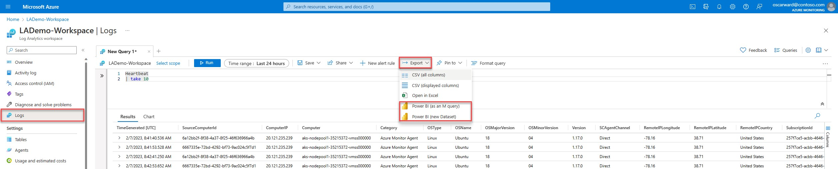
Exporting Queries to Power BI
Creating Power BI Datasets
Learn how to create Power BI datasets and reports from Log Analytics queries efficiently.
Export Menu Options
From the Export menu in Log Analytics, select options for exporting queries to Power BI.
M Query Export
Export the query as an M query to a .txt file for use in Power BI Desktop.
Notes:
Generated by Copilot Exporting queries to Power BI is a straightforward process that begins with selecting options from the Export menu in Log Analytics. Users can export queries as M queries, which are compatible with Power BI Desktop, allowing for further analysis and reporting. ______
--- This slide references information from the following file: https://microsoft-my.sharepoint.com/personal/chadtoney_microsoft_com/Documents/Documents/Teaching%20and%20Training/Feb%205%202025%20Log%20Analytics%20PBI/Log%20Analytics%20integration%20with%20Power%20BI%20and%20Excel%20-%20Azure%20Monitor%20_%20Microsoft%20Learn.pdf Create Power BI datasets and reports from Log Analytics queries From the Export menu in Log Analytics, select one of the two options for creating Power BI datasets and reports from your Log Analytics queries:  Power BI (as an M query): This option exports the query (together with the connection string for the query) to a .txt file that you can use in Power BI Desktop. Use this option if you need to model or transform the data in ways that aren't available in the Power BI service. Otherwise, consider exporting the query as a new dataset.

Slide 10
Creating New Datasets in Power BI
Creating Datasets
This option allows you to create a new dataset directly in Power BI, leveraging your query results.
Report Generation
Once the dataset is created, you can generate insightful reports to analyze the data effectively.
Export Limitations
Be aware of API limits when exporting large datasets, which may result in partial data exports.
Notes:
Generated by Copilot Creating new datasets in Power BI from query results is a powerful feature. This process not only allows for effective report generation but also requires awareness of API limits to avoid issues with large data exports. ______
--- This slide references information from the following file: https://microsoft-my.sharepoint.com/personal/chadtoney_microsoft_com/Documents/Documents/Teaching%20and%20Training/Feb%205%202025%20Log%20Analytics%20PBI/Log%20Analytics%20integration%20with%20Power%20BI%20and%20Excel%20-%20Azure%20Monitor%20_%20Microsoft%20Learn.pdf Power BI (new Dataset): This option creates a new dataset based on your query directly in the Power BI service. After the dataset has been created, you can create reports, use Analyze in Excel, share it with others, and use other Power BI features. For more information, see Create a Power BI dataset directly from Log Analytics. ７ Note The export operation is subject to the Lo g Anal y tics Q uer y API limit s . If your query results exceed the maximum size of data returned by the Query API, the operation exports partial results.

Slide 11
Collecting Data with Power BI Dataflows
Notes:
Generated by Copilot Power BI Dataflows are essential for collecting and storing data efficiently. They streamline the ETL process, ensuring that data is readily available for analysis and reporting. ______
--- This slide references information from the following file: https://microsoft-my.sharepoint.com/personal/chadtoney_microsoft_com/Documents/Documents/Teaching%20and%20Training/Feb%205%202025%20Log%20Analytics%20PBI/Log%20Analytics%20integration%20with%20Power%20BI%20and%20Excel%20-%20Azure%20Monitor%20_%20Microsoft%20Learn.pdf Using Dataflows for Data Collection and Storage

Slide 12

Using Dataflows for Data Collection and Storage
Dataflow Definition
A dataflow is a cloud-based ETL process that facilitates data collection and preparation for analysis.
Data Storage
Power BI dataflows not only collect but also store data, ensuring it is available for analysis and reporting.
Datasets as Models
Datasets act as models connecting different entities, tailored to meet specific analytical needs.
Notes:
Generated by Copilot Dataflows in Power BI serve as a cloud-based ETL process, enabling users to collect and prepare data for analysis. They also store data, ensuring it is accessible for reporting and analysis, which is crucial for informed decision-making. ______
--- This slide references information from the following file: https://microsoft-my.sharepoint.com/personal/chadtoney_microsoft_com/Documents/Documents/Teaching%20and%20Training/Feb%205%202025%20Log%20Analytics%20PBI/Log%20Analytics%20integration%20with%20Power%20BI%20and%20Excel%20-%20Azure%20Monitor%20_%20Microsoft%20Learn.pdf Collect data with Power BI dataflows Power BI dataflows also allow you to collect and store data. A dataflow is a type of cloud ETL (extract, transform, and load) process that helps you collect and prepare your data. A dataset is the "model" designed to help you connect different entities and model them for your needs.

Slide 13
Incremental Refresh in Power BI
Notes:
Generated by Copilot Incremental refresh is a valuable feature in Power BI that enhances data processing efficiency. By updating only the changed data, it saves time and resources, making it ideal for managing large datasets.
If you’re dealing with large amounts of Log Analytics data, it’s likely you’ll want to set up incremental refresh in Power BI. ______
--- This slide references information from the following file: https://microsoft-my.sharepoint.com/personal/chadtoney_microsoft_com/Documents/Documents/Teaching%20and%20Training/Feb%205%202025%20Log%20Analytics%20PBI/Log%20Analytics%20integration%20with%20Power%20BI%20and%20Excel%20-%20Azure%20Monitor%20_%20Microsoft%20Learn.pdf Overview and Benefits of Incremental Refresh, Configuring Incremental Refresh

Slide 14

Overview and Benefits of Incremental Refresh
Incremental Refresh Feature
Power BI datasets and dataflows support incremental refresh, which saves time and resources during data updates.
Efficiency in Data Processing
Incremental refresh updates smaller amounts of data, making it efficient for longer-running reports without reloading all data.
Datetime Field Requirement
A datetime field is essential for configuring incremental refresh in Power BI, ensuring accurate data updates.
Notes:
Generated by Copilot The benefits of incremental refresh in Power BI are significant. It allows for efficient data updates, reducing the load on the system and ensuring that reports remain current without the need to reload all data. ______
--- This slide references information from the following file: https://microsoft-my.sharepoint.com/personal/chadtoney_microsoft_com/Documents/Documents/Teaching%20and%20Training/Feb%205%202025%20Log%20Analytics%20PBI/Log%20Analytics%20integration%20with%20Power%20BI%20and%20Excel%20-%20Azure%20Monitor%20_%20Microsoft%20Learn.pdf Incremental refresh Both Power BI datasets and Power BI dataflows have an incremental refresh option. Power BI dataflows and Power BI datasets support this feature. To use incremental refresh on dataflows, you need Power BI Premium. Incremental refresh runs small queries and updates smaller amounts of data per run instead of ingesting all the data again and again when you run the query. You can save large amounts of data but add a new increment of data every time the query is run. This behavior is ideal for longer-running reports. Power BI incremental refresh relies on the existence of a datetime field in the result set. Before you configure incremental refresh, make sure your Log Analytics query result set includes at least one datetime field.

Slide 15

Configuring Incremental Refresh
Understanding Incremental Refresh
Incremental refresh allows you to efficiently manage large datasets by only refreshing data that has changed.
Power BI Datasets
Learn how to configure incremental refresh settings in Power BI datasets to optimize performance and data handling.
Power BI Dataflows
Explore the steps to configure incremental refresh in Power BI dataflows for better data processing.
Notes:
Generated by Copilot Configuring incremental refresh is essential for optimizing performance in Power BI. This feature allows users to manage large datasets effectively by refreshing only the necessary data, which is crucial for maintaining system efficiency. ______
--- This slide references information from the following file: https://microsoft-my.sharepoint.com/personal/chadtoney_microsoft_com/Documents/Documents/Teaching%20and%20Training/Feb%205%202025%20Log%20Analytics%20PBI/Log%20Analytics%20integration%20with%20Power%20BI%20and%20Excel%20-%20Azure%20Monitor%20_%20Microsoft%20Learn.pdf To learn more and how to configure incremental refresh, see Power BI datasets and incremental refresh and Power BI dataflows and incremental refresh.

Slide 16
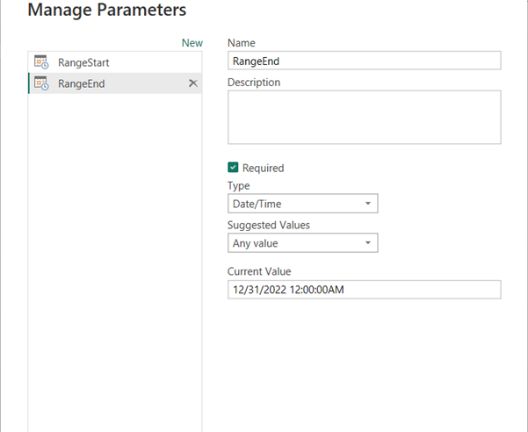
Configuring Incremental Refresh
Create Parameters
In this task, you'll use Power Query Editor to create RangeStart and RangeEnd parameters with default values.
Notes:
In this process, we will focus on creating two essential parameters: RangeStart and RangeEnd. These parameters will help define the time frame for the data that needs to be refreshed. By setting default values for these parameters in Power Query Editor, we ensure that our data model only processes the necessary data, improving performance and efficiency. This approach not only saves time but also reduces the load on our data sources. As we proceed, keep in mind how these parameters will interact with your data queries and the overall impact on your reporting capabilities.

Slide 17
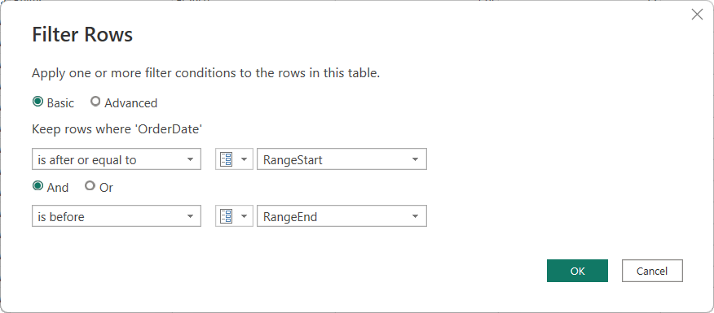
Configuring Incremental Refresh
Filter Data
You'll now apply a filter based on conditions in the RangeStart and RangeEnd parameters.
Notes:
By applying filters based on the RangeStart and RangeEnd parameters, we can effectively control the volume of data being processed. This not only enhances performance but also ensures that we are working with the most relevant and timely information. It's important to consider how these filters will impact data retrieval and refresh cycles, as they can significantly reduce load times and improve overall efficiency. As we move forward, let's keep in mind the best practices for setting these parameters to maximize our data handling capabilities.

Slide 18
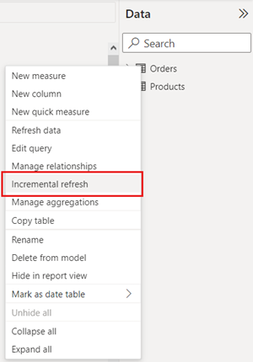
Configuring Incremental Refresh
Define policy
This policy is applied only after the model is published to the service, and a manual or scheduled refresh operation is performed.
Notes:
Generated by Copilot Configuring incremental refresh is a crucial step for optimizing data management in Power BI. It allows you to define a refresh policy that only updates the data that has changed since the last refresh, rather than reloading the entire dataset. This policy becomes effective once the model is published to the service, ensuring that your reports and dashboards reflect the most current data without unnecessary processing time. It's important to note that this policy is activated during either a manual or scheduled refresh operation, which can significantly enhance performance and reduce resource consumption. By implementing this strategy, organizations can maintain up-to-date insights while improving efficiency. ______
Generated by Copilot Configuring incremental refresh is essential for optimizing performance in Power BI. This feature allows users to manage large datasets effectively by refreshing only the necessary data, which is crucial for maintaining system efficiency. ______
--- This slide references information from the following file: https://microsoft-my.sharepoint.com/personal/chadtoney_microsoft_com/Documents/Documents/Teaching%20and%20Training/Feb%205%202025%20Log%20Analytics%20PBI/Log%20Analytics%20integration%20with%20Power%20BI%20and%20Excel%20-%20Azure%20Monitor%20_%20Microsoft%20Learn.pdf To learn more and how to configure incremental refresh, see Power BI datasets and incremental refresh and Power BI dataflows and incremental refresh.

Slide 19
Creating Reports and Dashboards
Notes:
Generated by Copilot Creating reports and dashboards in Power BI is a key aspect of data visualization. This process enables users to present data in a way that is both informative and engaging. ______
--- This slide references information from the following file: https://microsoft-my.sharepoint.com/personal/chadtoney_microsoft_com/Documents/Documents/Teaching%20and%20Training/Feb%205%202025%20Log%20Analytics%20PBI/Log%20Analytics%20integration%20with%20Power%20BI%20and%20Excel%20-%20Azure%20Monitor%20_%20Microsoft%20Learn.pdf Using Power BI for Reports and Dashboards

Slide 20

Using Power BI for Reports and Dashboards
Creating Reports
Power BI allows users to create dynamic reports that visualize data effectively for better insights.
Building Dashboards
Users can build interactive dashboards in Power BI to monitor key metrics and data at a glance.
Data Integration
Once data is imported into Power BI, users can seamlessly integrate and visualize it in reports and dashboards.
Notes:
Generated by Copilot Power BI empowers users to create dynamic reports and interactive dashboards that provide valuable insights. By integrating data seamlessly, users can monitor key metrics and visualize data effectively. ______
--- This slide references information from the following file: https://microsoft-my.sharepoint.com/personal/chadtoney_microsoft_com/Documents/Documents/Teaching%20and%20Training/Feb%205%202025%20Log%20Analytics%20PBI/Log%20Analytics%20integration%20with%20Power%20BI%20and%20Excel%20-%20Azure%20Monitor%20_%20Microsoft%20Learn.pdf Reports and dashboards After your data is sent to Power BI, you can continue to use Power BI to create reports and dashboards. For more information, see Create and share your first Power BI report.

Slide 21
Demo

